Slide 1





Happy Holidays!
SEDONA FIRE DISTRICT
GOVERNING FIRE BOARD
DECEMBER 2024

Slide 2





NEW BOARD MEMBERS - SWEARING IN
(TO BE SEATED IN JANUARY)
DIANA CHRISTENSEN
LANCE WALDROP
WELCOME TO THE GOVERNING FIRE BOARD!

Slide 3


consent agenda
NOVEMBER 19, 2024 REGULAR & EXECUTIVE SESSION MINUTES

Slide 4



FINANCIAL UPDATES
JVG ASSOCIATES
NOVEMBER 2024

Slide 5
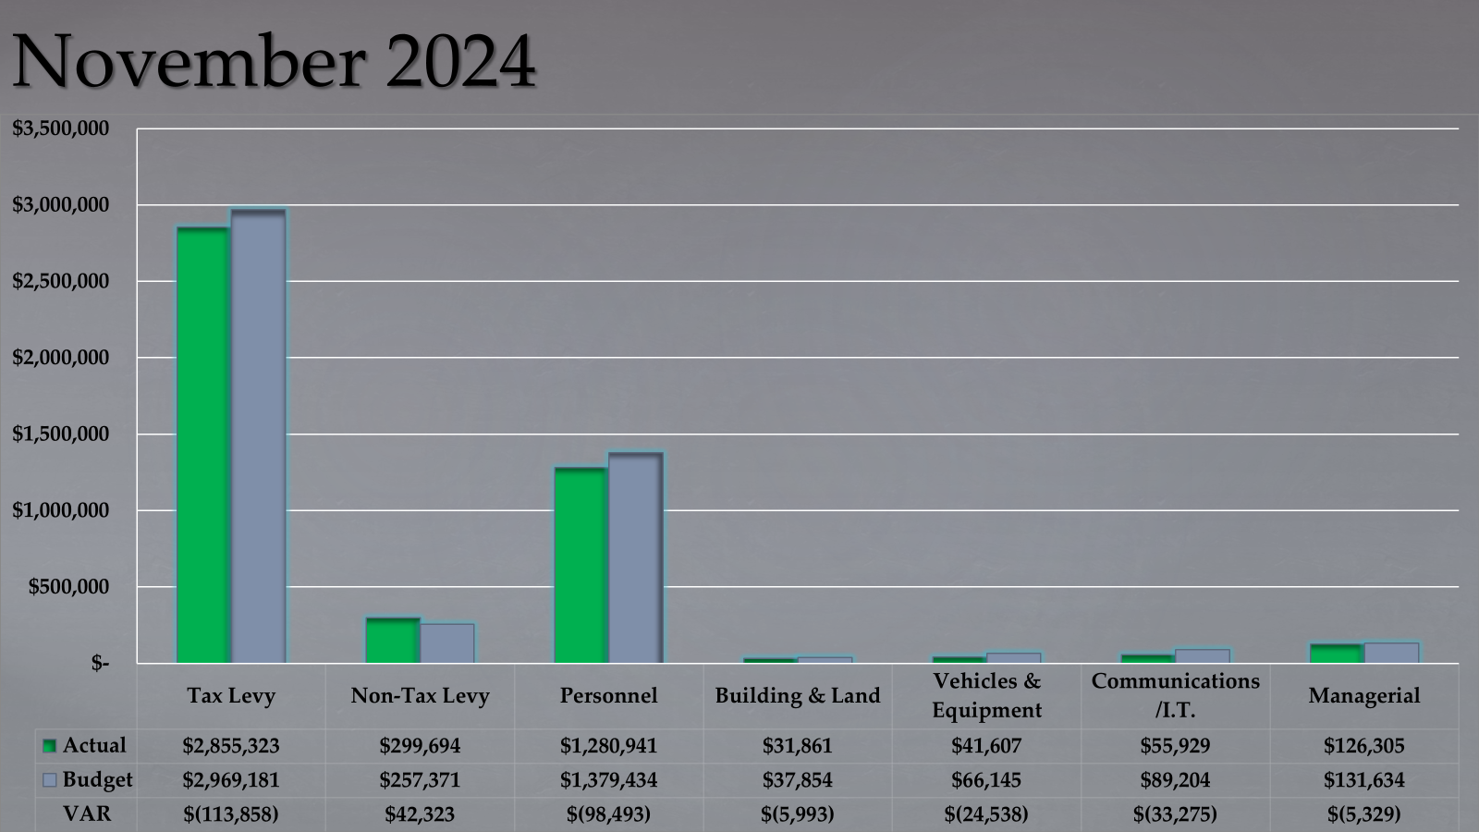

Slide 6
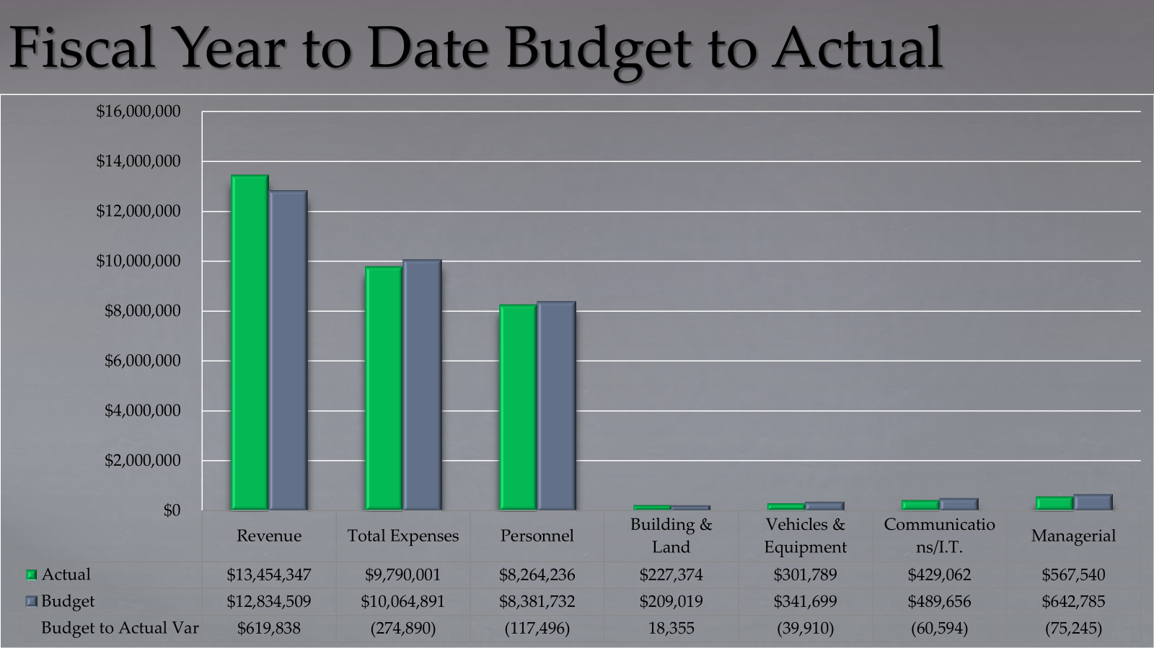

Slide 7
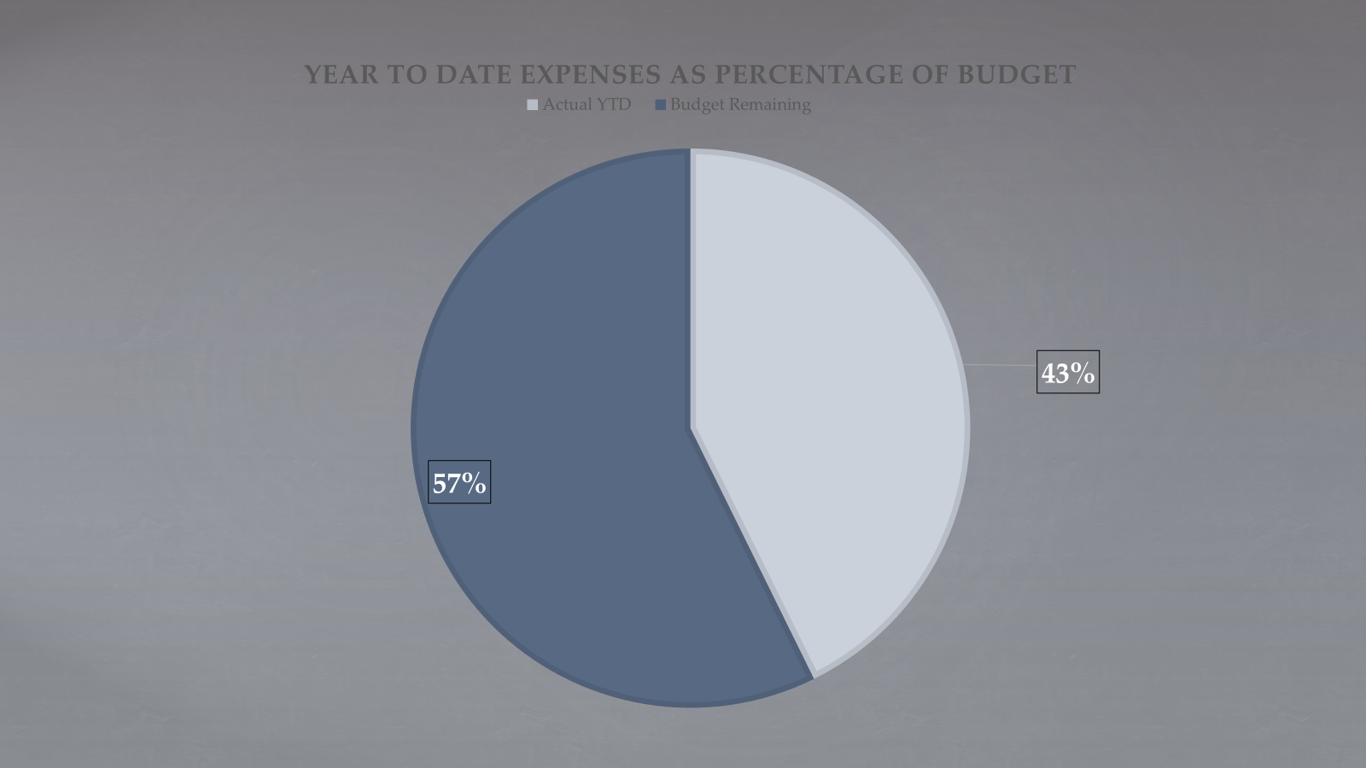

Slide 8
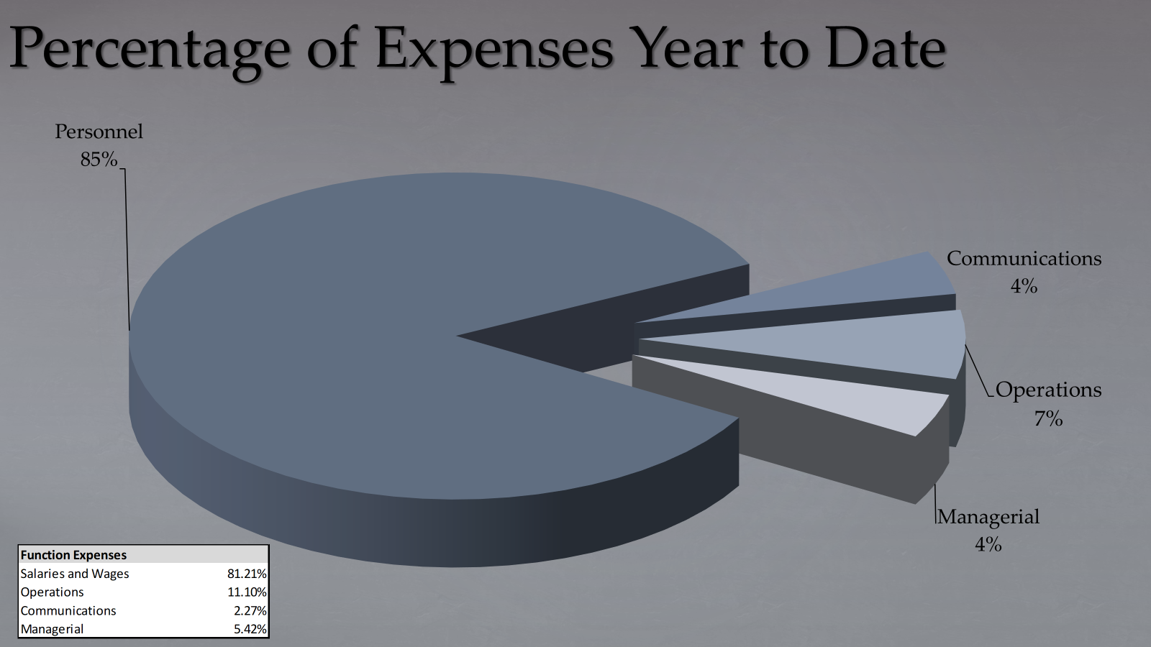

Slide 9
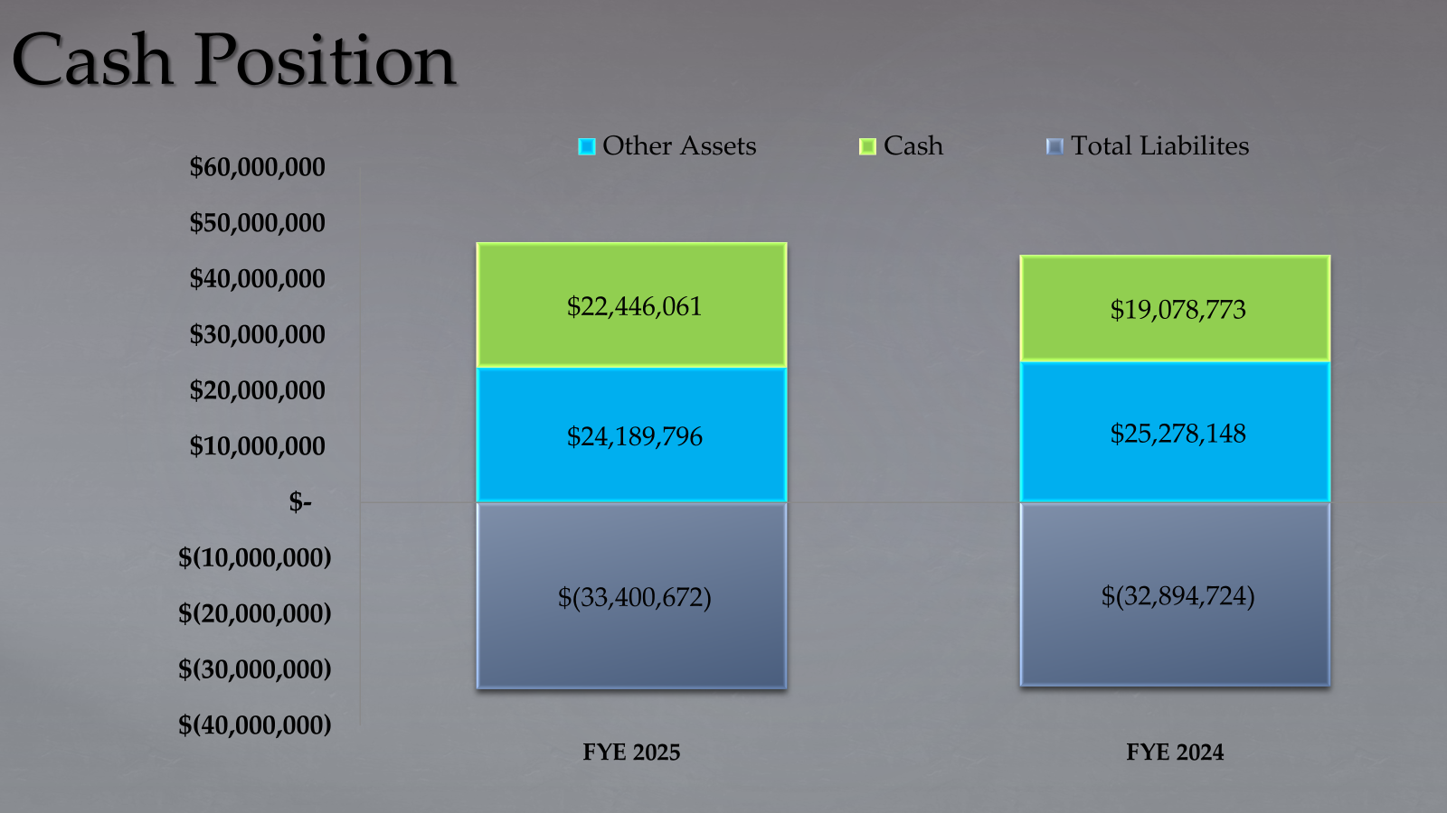

Slide 10



We wish you calmness and peace.
STAFF & DIVISION UPDATES

Slide 11



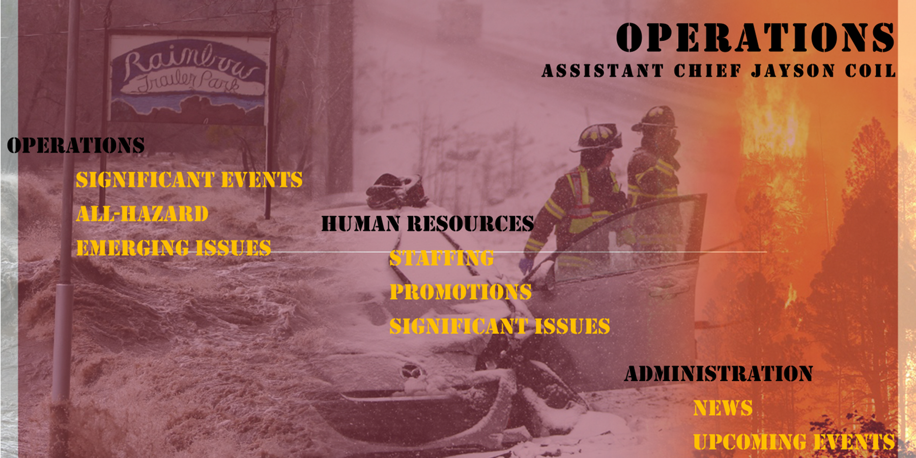

Slide 12

Safety Message – Charge into Fire Safety™
Safety Tips
Signs of a Problem
  Use only the charging cord that came with the device
  Do not charge a device under your pillow, on your bed, or on a couch.
  Do not keep charging the device or device battery after it is fully charged
  Keep batteries at room temperature when possible. Do not charge them at temperatures below 32°F (0°C) or above 105°F (40°C)
  Use only the battery that is designed for the device
  Odor
  Change in color
  Too much heat
  Change in shape
  Leaking
  Odd noises
Additional Resources
  NFPA.org
    Lithium-Ion Battery Safety
  Consumer Product Safety Commission
    CPSC.gov
2

Slide 13
Safety Message – Charge into Fire Safety™
Safety Tips
Signs of a Problem
  Use only the charging cord that came with the device
  Do not charge a device under your pillow, on your bed, or on a couch.
  Do not keep charging the device or device battery after it is fully charged
  Keep batteries at room temperature when possible. Do not charge them at temperatures below 32°F (0°C) or above 105°F (40°C)
  Use only the battery that is designed for the device
  Odor
  Change in color
  Too much heat
  Change in shape
  Leaking
  Odd noises
Additional Resources
  NFPA.org
    Lithium-Ion Battery Safety
  Consumer Product Safety Commission
    CPSC.gov
2

Slide 14







FG PIE-DIVISION CHIEF BUZZ LECHOWSKI
  FLEET
  GIS
  PEER SUPPORT/MENTAL HEALTH
  IT/TELECOM
  EMS

Slide 15
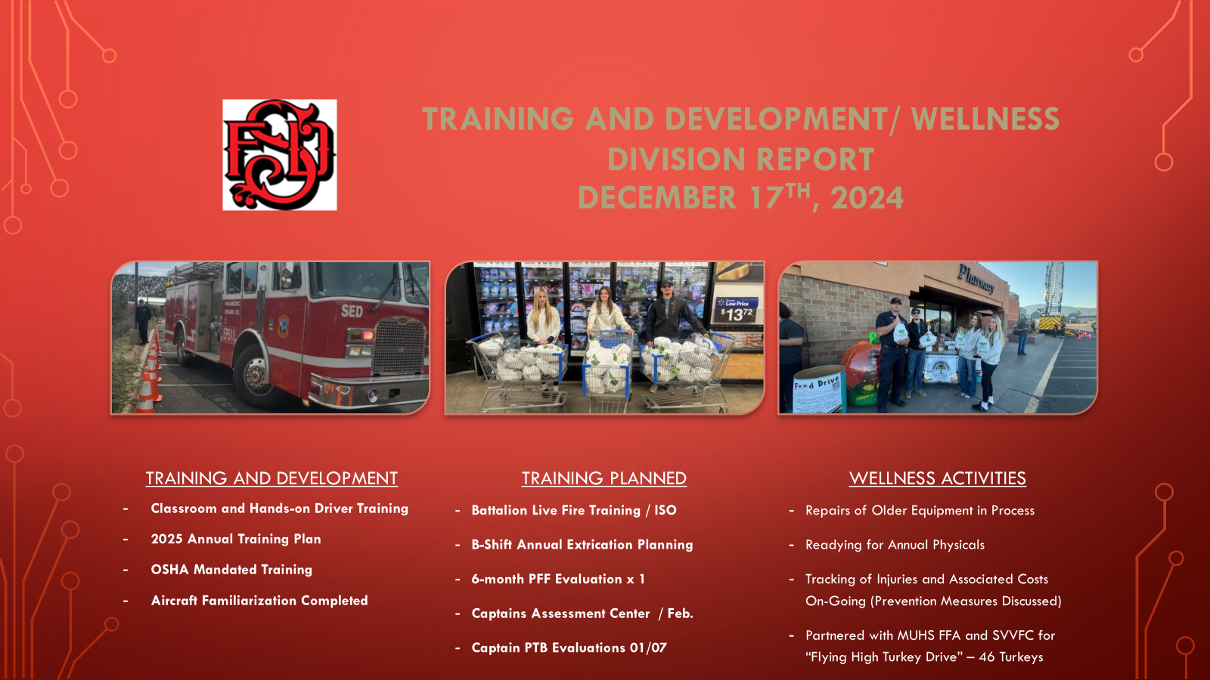

Slide 16
chief’s report
FIRE CHIEF ED MEZULIS

Slide 17
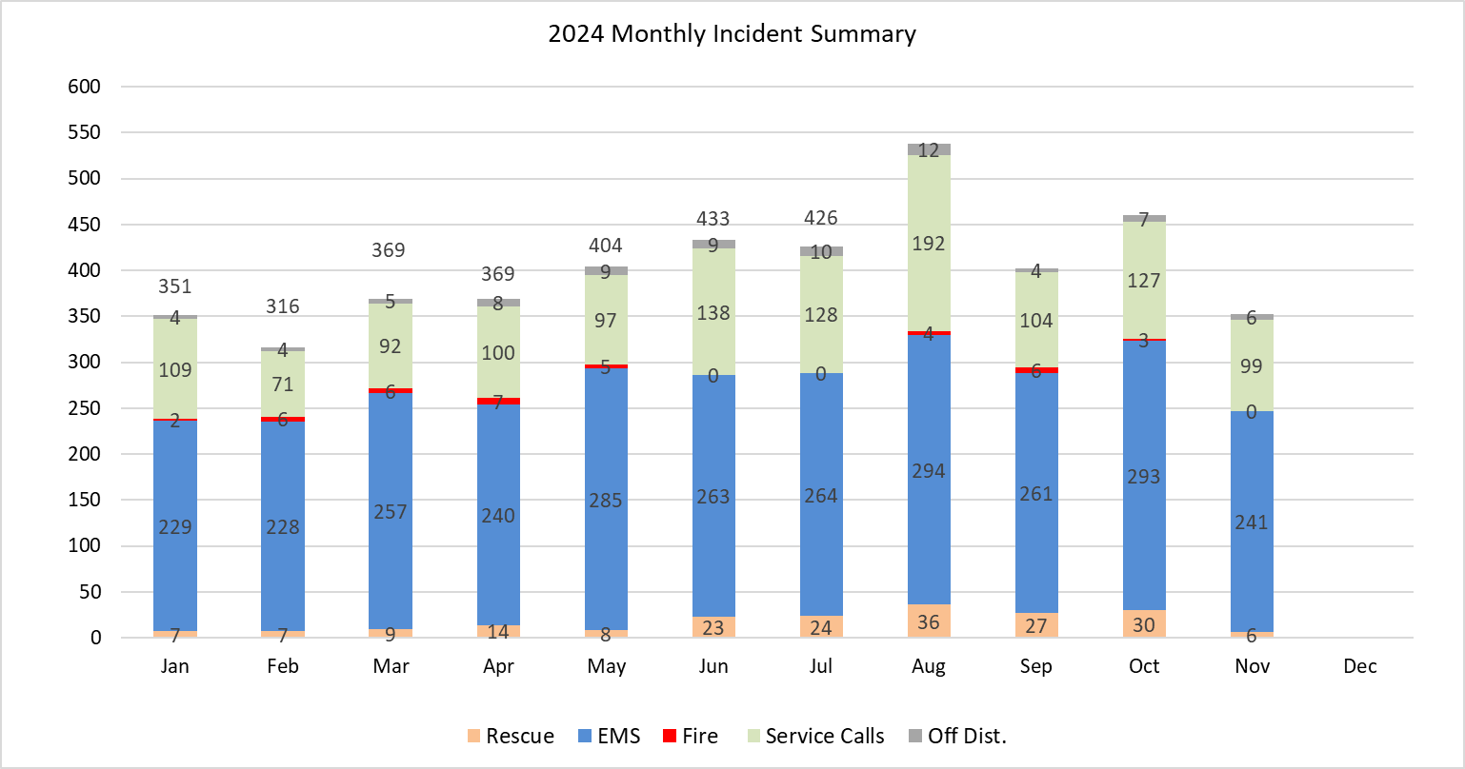
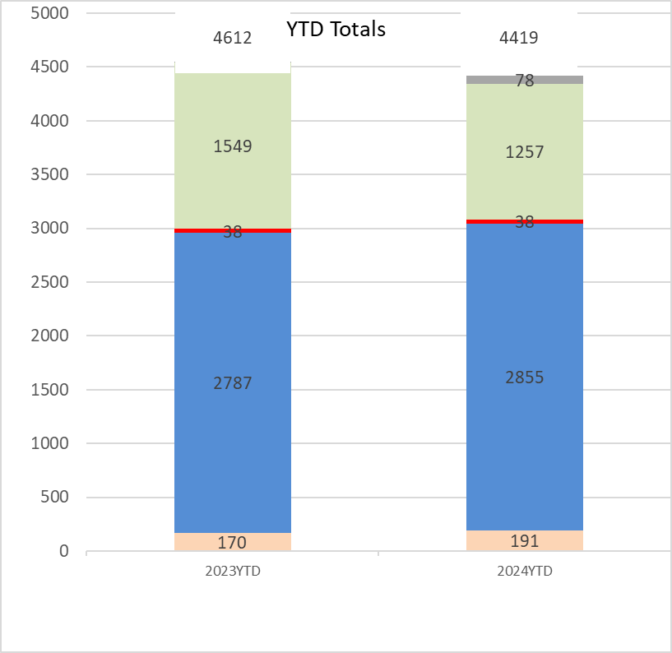
THE INCIDENT SUMMARY PROVIDES AN OVERVIEW OF THE NUMBER OF
CALLS FOR EACH MONTH AND THE TYPE OF INCIDENTS. A YEAR-TO-DATE
COMPARISON OF THE PRIOR YEAR IS PROVIDED TO VIEW HOW SFD’S
CALLS ARE TRENDING FROM THE YEAR PRIOR.

Slide 18


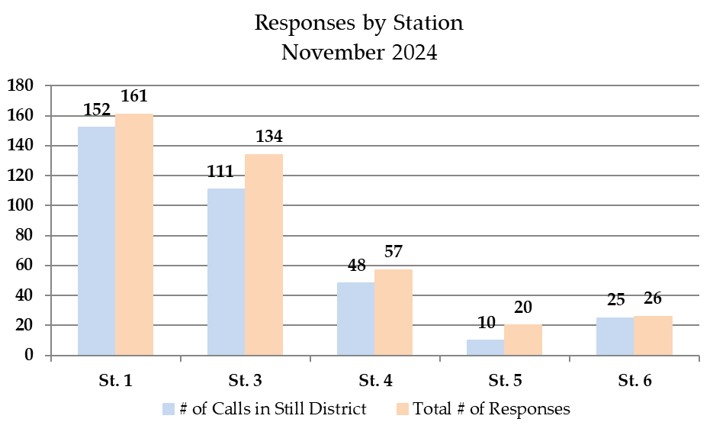
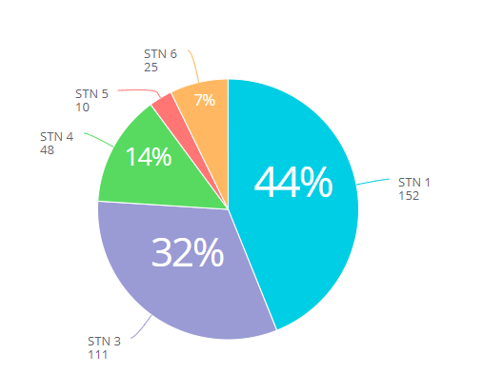
THE CHART SHOWS THE TOTAL NUMBER OF CALLS RECEIVED IN EACH STATION’S RESPONSE AREA, COMPARED TO THE TOTAL NUMBER OF CALLS TO WHICH EACH STATION’S CREWS RESPONDED. STATION CREWS NOT ONLY RESPOND TO THEIR OWN AREA, BUT, WHEN NEEDED, TO OTHER AREAS OF THE FIRE DISTRICT

Slide 19

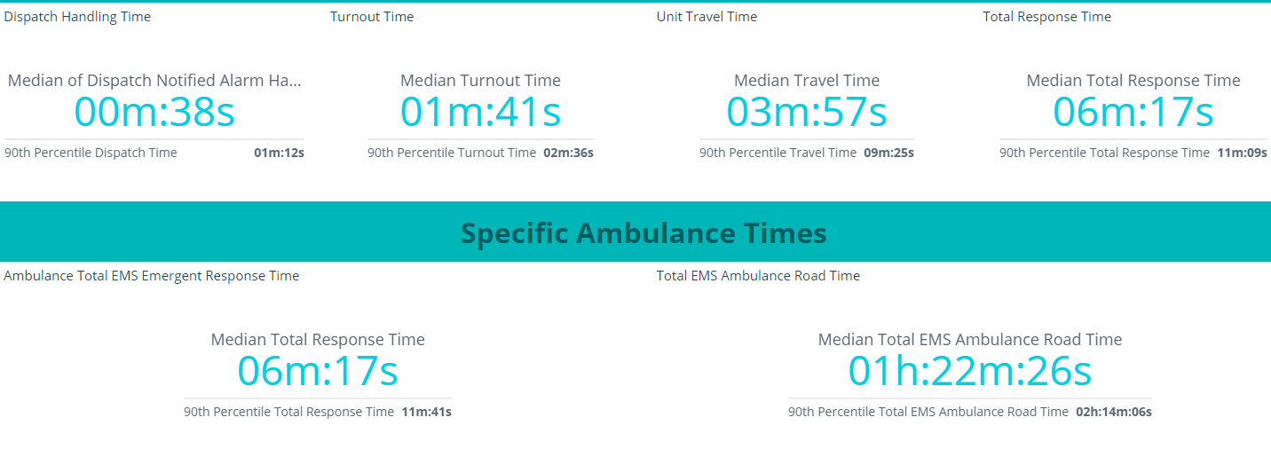
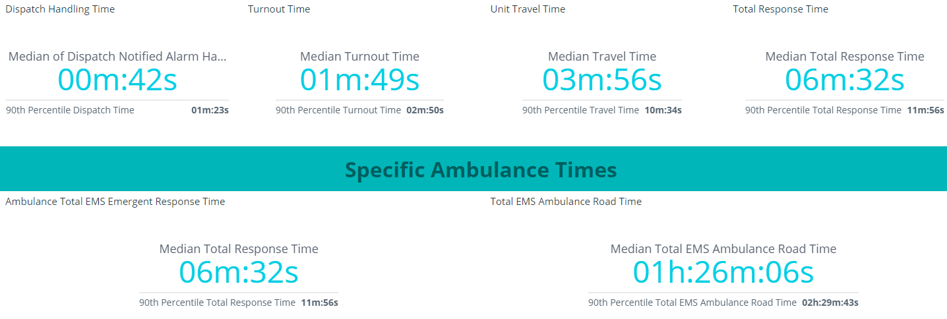
NOVEMBER 2024
NOVEMBER 2023

Slide 20
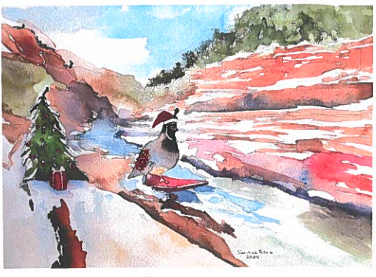
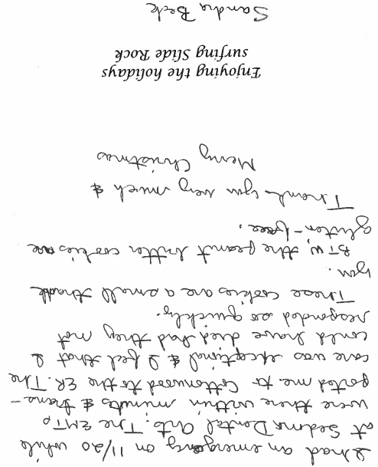
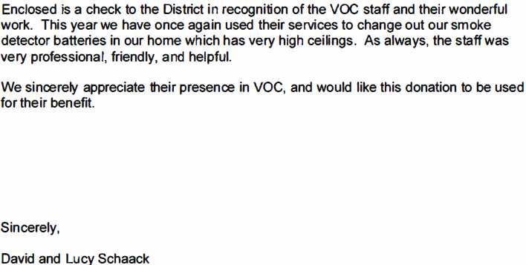
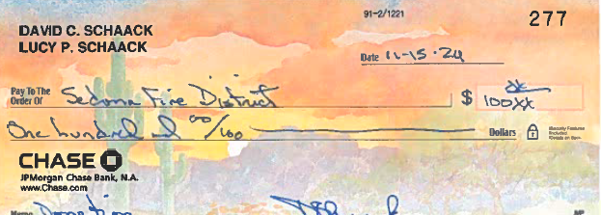
COMMUNITY THANKS & APPRECIATION

Slide 21
EXECUTIVE SESSION
OPEN PUBLIC SESSION WILL RESUME WHEN EXECUTIVE SESSION IS COMPLETED.
MICROSOFT TEAMS
JOIN THE MEETING NOW
MEETING ID: 260 905 087 538
PASSCODE: CFAYSN
IF YOU GET DISCONNECTED, PLEASE REJOIN AT:
DIAL IN BY PHONE
+1 312-625-2555,372741307# UNITED STATES PHONE CONFERENCE ID: 372 741 307

Slide 22



have a wonderful HOLIDAY SEASON!
FROM SEDONA FIRE DISTRICT
GOVERNING BOARD AND STAFF
DECEMBER 17, 2024

